Slide 1
English Writing II
Week 4 Presenting the information

Slide 2
Lesson plan
Review of Assignment 2
Presenting the information
→ Interpreting data and numbers
→ explaining concepts and terms
→ Using analogies to explain

Slide 3
Review of Assignment 2
A COVID-19 Case Report
→ An in-depth report vs. a news brief
Different materials – facts, opinions, data, etc.
Details, details, details
Close-up (Samples of Assignment 2).docx

Slide 4
Interpreting numbers and data
Pandemics have recurred in cycles for centuries. The great flu of 1918 killed at least fifty million people and infected hundreds of millions of others. In the United States, it took more lives than all combat in the twentieth century.

Slide 5

Interpreting numbers and data
One historian has estimated that if the dead from Nanking were to link hands, they would stretch from Nanking to the city of Hangchow, spanning a distance of some two hundred miles. (The Rape of Nanking, by Iris Chang)

Slide 6
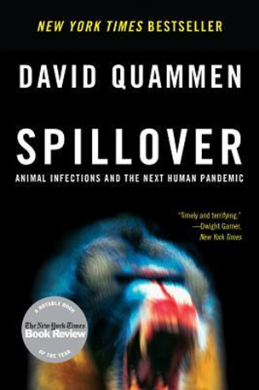
Interpreting numbers and data
The order Chiroptera (the “hand-wing” creatures) encompasses 1,116 species, which amounts to 25 percent of all the recognized species of mammals. To say again: One in every four species of mammal is a bat.

Slide 7
In-class writing 401 （5 minutes）
Huoshenshan Hospital, with an area of 33,900 square meters and a capacity of more than 1,000 beds, officially began treating novel coronavirus infected patients on Feb 4 – and it was built in merely 10 days.
Over 41,000 medical workers from across China join forces to treat virus patients

Slide 8

Explaining concepts and terms
Definition, exemplification, analogy, etc.

Slide 9
Anything contagious is always automatically infectious: if you can catch it from someone, it's being passed to you via an infectious agent. But the reverse isn't true. Just because something is infectious does not mean it's contagious. Food poisoning is a good example of something infectious but not contagious: food can be contaminated with a bacteria that makes you sick, but you can't give your food poisoning to someone else just by shaking their hand or even giving them a kiss. (Merrian-Webster)

Slide 10

Contagious vs. infectious
Ebolavirus have force but not reach. You can’t catch one by breathing shared air, but if a smidgen of the virus get through a break in your skin (and there are always tiny breaks), God help you. In the terms used by the scientists: it’s not very contagious but it is highly infectious. (Spillover by D. Quammen)

Slide 11
In-class writing 402 (5 minutes)
Write a paragraph of about 40 words to distinguish the two words (contagious vs. infectious) with precision and vividness.

Slide 12
Using analogies to explain
Electricity
Sound/light/radio
Blood vessels
DNA
Eye
Brain
Flowing water
Wave
Highways
Blueprint
Camera
Computer

Slide 13
Using analogies (vs. metaphors)
Analogy is used to demonstrate how two things are similar while metaphor is used to get your point across in a more emphatic manner.
A metaphor is a direct comparison of two totally different things whereas an analogy is comparing two things with a set of another two things.

Slide 14
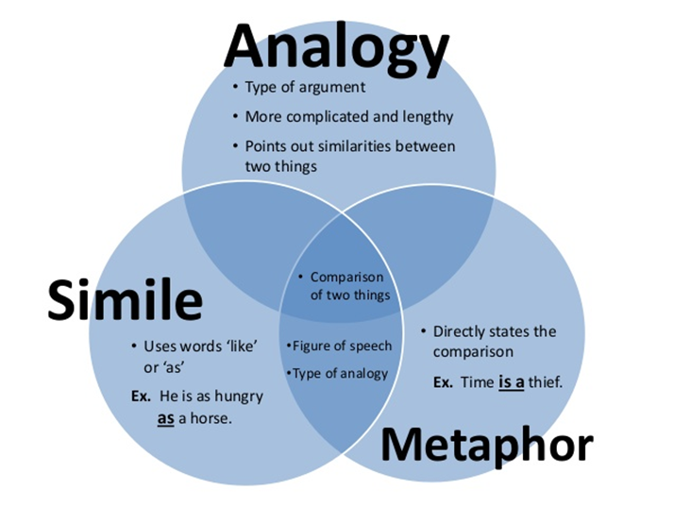
Using analogies to explain
The point of an analogy is not merely to show, but also to explain.
Metaphor is final and there is no need for any more explanation whereas analogy makes use of another set to make things clear.

Slide 15
Analogies in text (p. 52)
A pandemic is the viral equivalent of a perfect storm.
Infectious-disease experts talk about pandemics the way geologists talk about earthquakes – the discussion is never about whether “the big one” will hit.

Slide 16
Compare…
This virus is playing its role as a natural bioterrorist.
Hong Kong has often served as a cauldron for viral diseases.

Slide 17
Analogies in text (p. 53)
But take the example of a football player. Maybe he is even a bad football player. So he’s kicking the ball ten, fifteen, twenty times toward the goal before he scores. A good player does it once. This virus is not a good scorer. But even the worst scorer is going to make it one time. And in this game it’s going to take only one goal for the virus to win.

Slide 18
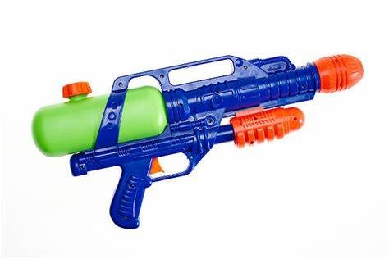
Analogies in text (p. 60)
My analogy is a spark and a squirt gun. If you aim properly, you can get the spark and be done with it. If you miss, though, the fire is going to spread and there is nothing you can do to stop it.

Slide 19
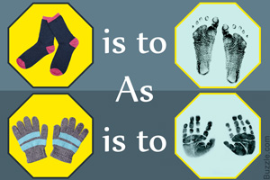
In-class writing 403 (10 minutes)
Use an analogy to explain a concept, an idea, a relationship, etc.
The vaccine, the virus, an epidemic, …
The doctors, the community workers…
Wearing surgical masks
Locking down cities

Slide 20
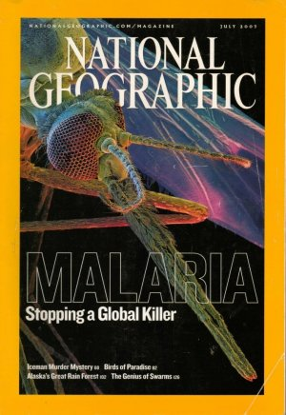
Homework
Writing: Consider how to integrate the previous writings into a coherent and logical unity.
Reading: Stopping a Global Killer
→ Background & general understanding

